Slide 1


TOPIC : CLASSICAL CRYPTOGRAPHY
Topics Covered:
Substitution Cipher
Transposition Cipher
Ceasar Cipher/Bruteforce Ceasar Cipher.
Vigenère cipher
Rail Fence Cipher
Playfair Cipher
OTP(One Time Pad)
Affine Cipher(Only Encryption)

Slide 2
CLASSIFICATION OF CRYPTOSYSTEMS
The type of operations used for transforming plaintext to ciphertext
Substitution
Transposition
The number of keys used
Symmetric
Asymmetric
The way in which the plaintext is processed
Block
Stream
The Classical vs Modern ciphers
Classical algorithms
Modern cryptography

Slide 3
CLASSIFICATION OF CRYPTOSYSTEMS
The Classical vs Modern ciphers
Classical algorithms – those were invented pre-computer up until around the 1950's.
schemes were designed in an ad-hoc manner and then evaluated based on their perceived complexity/cleverness
true ‘strength’ of these schemes was in ‘secrecy’ of their respective protocols/methods.
Modern cryptography – based on scientific foundations
The strength is NOT in secrecy of protocols but in sound mathematical and computational principles.
used for more than just data confidentiality, can protect data integrity, enable user authentication, etc.

Slide 4
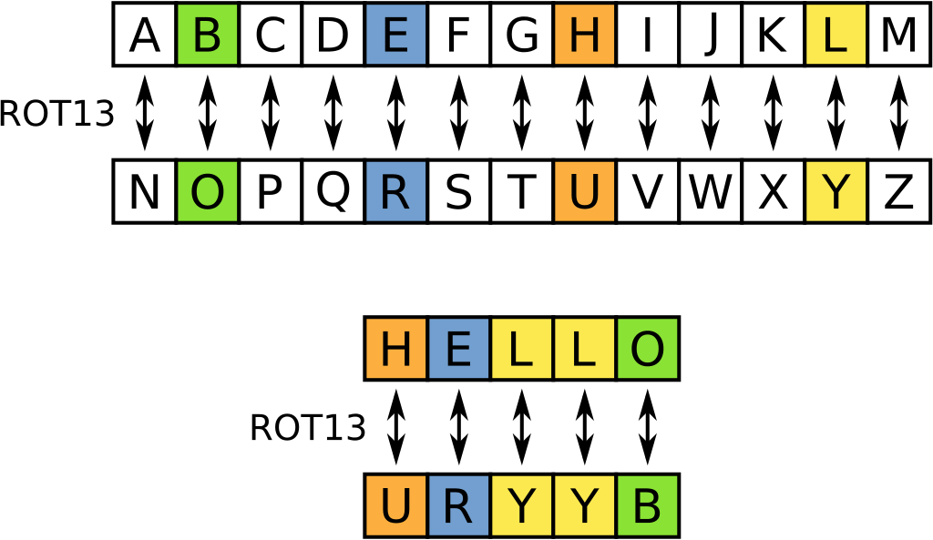
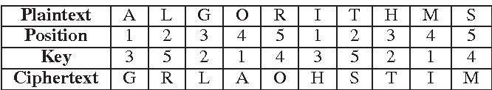
CLASSIFICATION OF CRYPTOSYSTEMS
The type of operations used for transforming plaintext to ciphertext
Substitution: each element in the plaintext (bit, letter, group of bits or letters) is mapped into another element.
Transposition: elements in the plaintext are rearranged.

Slide 5
SUBSTITUTION CIPHERS
Monoalphabetic substitution:
each character of the plaintext is replaced with a corresponding character of cipher text.
The cryptograms in newspapers are simple substitution ciphers.
Example: Caesar Cipher
Polyalphabetic substitution:
cipher is made up of multiple monoalphabetic substitutions.
Example: Vigenere Cipher
* In classical cryptography, there are four types of substitution ciphers, only two will be considered

Slide 6
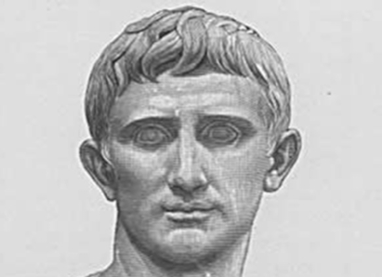
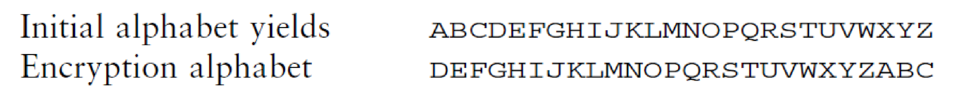
CAESAR CIPHER
Julius Caesar, was a Roman politician, military general, and historian who played a critical role in the events that led to the demise of the Roman Republic and the rise of the Roman Empire.
Caesar Cipher is the earliest known substitution cipher, by Julius Caesar.
Caesar Cipher involves replacing each letter of the alphabet with the letter standing some fixed places further down the alphabet.

Slide 7
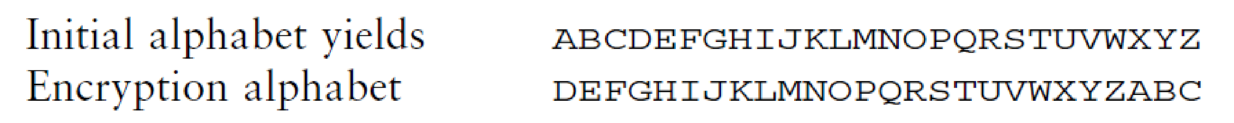

CAESAR CIPHER (MONOALPHABETIC-SUBSTITUTION CIPHER)
Three character substitution to the right
We can describe Cesar by this following substitution : Cesar Encryption can be expressed by: If key(k)=3 and input =‘p’
The shifting can be generalised to any number k :
c = E (k, p) = (p + k )mod 26
c = E (3, p) = (p + 3)mod 26=‘s’.
if k ∈ [1, 25], then Cesar decryption is expressed by :
p = D(k, c) = (c − k )mod 26 = (s-3)mod26 = p.

Slide 8
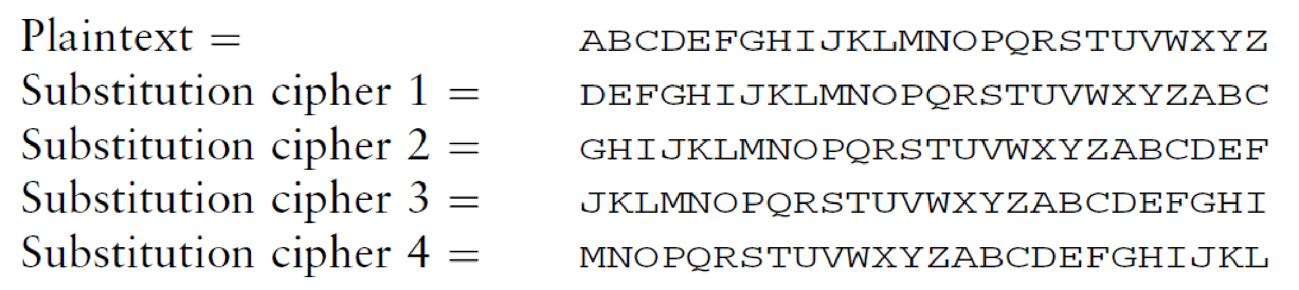
CAESAR CIPHER (SINGLE POLYALPHABETIC)
Notice how the letter K is transformed into W or N depending on its order of appearance in the plain text
Activity : Try to encrypt your name with key = 13

Slide 9
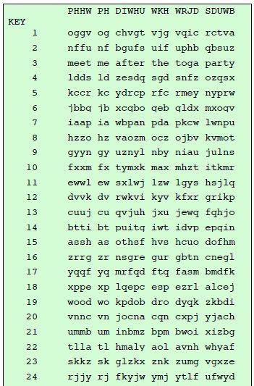
Brute force attack on Cesar :try all 26 combinations

Slide 10
VIGENÈRE CIPHER-POLYALPHABETIC CIPHERS
An advanced type of substitution cipher that uses a simple polyalphabetic code is the Vigenère cipher.
The cipher is implemented using the Vigenère square (or table), which is made up of twenty-six distinct cipher alphabets.
In the header row, the alphabet is written in its normal order. In each subsequent row, the alphabet is shifted one letter to the right until a 26x26 block of letters is formed.

Slide 11
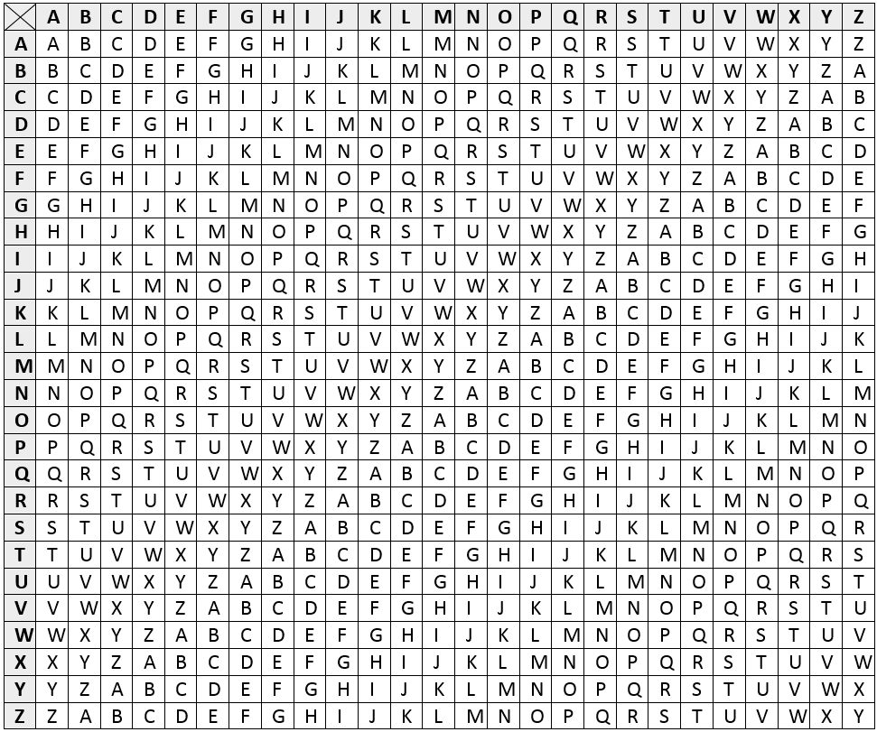

Slide 12
VIGENÈRE CIPHER
Simple way (similar to Caeser single polyalphabetic)
Sophisticated way (using keyword)
Plaintext: | S | E | C | U | R | I | T | Y
Ciphertext: | T | G | F | Y | W | O | A | G
Keyword | I | B | R | I | I | B | R | I
Plaintext: | S | E | C | U | R | I | T | Y
Ciphertext: | A | F | T | C | Z | J | K | G

Slide 13

TRANSPOSITION CIPHER
Rail Fence Cipher
Simplest transposition cipher
Plaintext is written down as a sequence of diagonals and then read off as a sequence of rows
To encipher the message “meet me after the toga party” with a rail fence of depth 2, we would write:

Slide 14
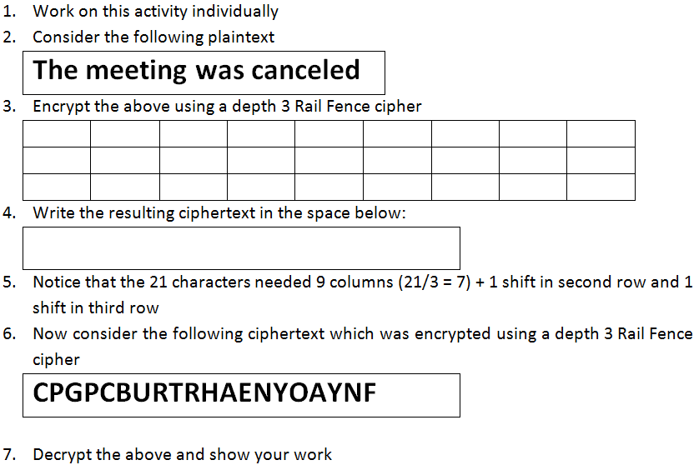
Rail Fence Cipher Activity

Slide 15
PLAYFAIR CIPHER
Step 1: Construct the MATRIX
Simple way (without keyword)
5x5 table
Skip letter J or combine I and J
Sophisticated way (keyword)
Keyword has No repeating letter
5x5 table
fill in the remaining letters in alphabetic order (skip letter J or combine I and J)
A | B | C | D | E
F | G | H | I | K
L | M | N | O | P
Q | R | S | T | U
V | W | X | Y | Z
K | E | Y | W | O
R | D | A | B | C
F | G | H | I | L
M | N | P | Q | S
T | U | V | X | Z

Slide 16
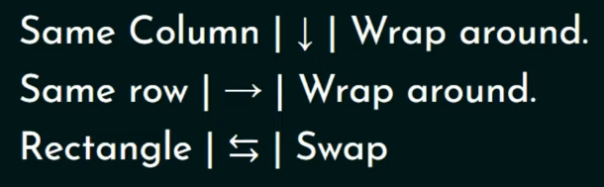
PLAYFAIR CIPHER
Step 2: Preparing your message
Message must be split into pairs
Repeating plaintext letters that are in the same pair are separated with X
If there is an odd letter at the end of the message insert the letter X
Step 3: Encoding Rules
Insert each pair into a separate table
Rule 1: if they fall in the same column
- Move each letter down one position
- Upon reaching end of table, wrap around
Rule 2: if they fall in the same row
- Move each letter right one position
- Upon reaching end of table, wrap around
Rule 3: if it form a rectangle
- Swap the letters with the ones on the end of the rectangle

Slide 17
SECURITY OF PLAYFAIR
Improved security since there are a total of 26 × 26 = 676 diagrams
we need a frequency analysis on 676 units and no longer on 26 like the monoalphabetic
so the ciphertext alphabet is also huge
but it can be broken if we know a hundred of plaintext/ciphertext...

Slide 18
PLAYFAIR CIPHER
GR
MW
HK
IF
MY
OW
A | B | C | D | E
F | G | H | I | K
L | M | N | O | P
Q | R | S | T | U
V | W | X | Y | Z

Slide 19


PLAYFAIR CIPHER (SIMPLE)
WELCOME
A | B | C | D | E
F | G | H | I | K
L | M | N | O | P
Q | R | S | T | U
V | W | X | Y | Z
WE
LC
OM
EX
ZB
NA
PN
CZ
ZBNAPNCZ

Slide 20
PLAYFAIR CIPHER (SOPHISTICATED)
WELCOME
M | O | N | A | R
C | H | Y | B | D
E | F | G | I | K
L | P | Q | S | T
U | V | W | X | Z
WE
LC
OM
EX
UG
UE
NO
IU
UGUENOIU

Slide 21
PLAYFAIR CIPHER (SIMPLE)
WELCOME HOME
A | B | C | D | E
F | G | H | I | K
L | M | N | O | P
Q | R | S | T | U
V | W | X | Y | Z
WELCOMEHOME
WE
LC
OM
EH
OM
EX
ZB
NA
PN
CK
PN
CZ
ZBNAPNCKPNCZ

Slide 22
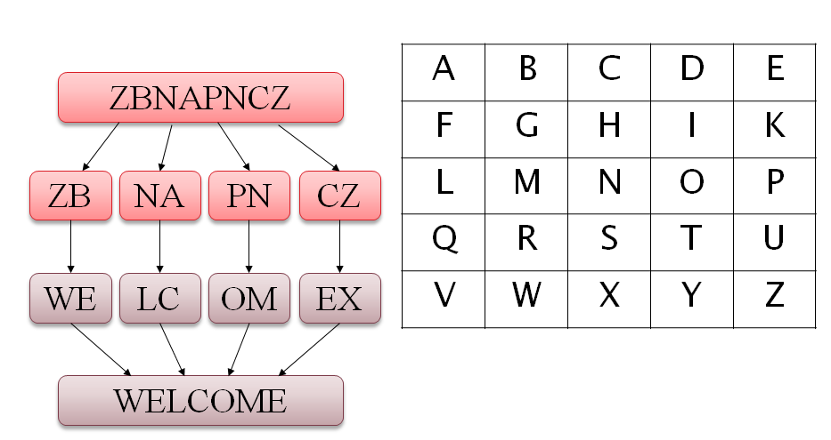
PLAYFAIR CIPHER
Repeating plaintext letters that are in the same pair are separated with X
BALLOON 🡪 BA LL OO NX
BALLOON 🡪 BA LX LO ON
🗶
✔

Slide 23
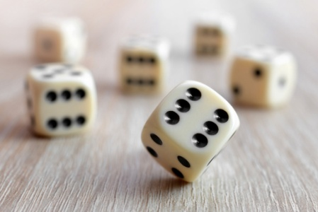
ONE-TIME PAD
One-time pad cipher is a type of Vignere cipher
Fix the vulnerability of the Vigenere cipher by using long keys
It is an unbreakable cipher
Key is a random string that is at least as long as the plaintext
The key is made up of random symbols
Each key should be used once and destroyed by both sender and receiver.

Slide 24
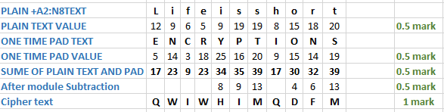
ENCRYPTION
The plain text : “LIFE IS SHORT”
key : “ENCRYPTIONS”

Slide 25
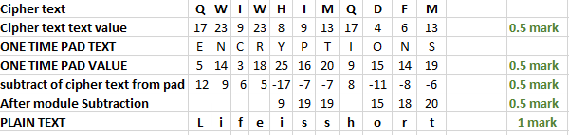
DECRYPTION
Cipher text: “QWIWHIMQDFM”
key : “ENCRYPTIONS”

Slide 26
PROBLEMS WITH ONE-TIME PAD
Key must be as long as the plaintext
Impractical in most realistic scenarios
Still used for diplomatic and intelligence traffic
Does not guarantee integrity
One-time pad only guarantees confidentiality
Attacker cannot recover plaintext, but can easily change it to something else
Insecure if keys are reused
Attacker can obtain XOR of plaintexts

Slide 27
AFFINE CIPHER
Encryption/Decryption The first step in the encryption process is to transform each of the letters in the plaintext alphabet to the corresponding integer in the range 0 to m-1. With this done, the encryption process for each letter is given by
E(x) = (ax + b) mod m
where a and b are the key for the cipher.
D(x) = c(x - b) mod m where c is the modular multiplicative inverse of a.
Plain Text Alphabet | a | b | c | d | e | f | g | h | i | j | k | l | m | n | o | p | q | r | s | t | u | v | w | x | y | z
Plain Text Value | 0 | 1 | 2 | 3 | 4 | 5 | 6 | 7 | 8 | 9 | 10 | 11 | 12 | 13 | 14 | 15 | 16 | 17 | 18 | 19 | 20 | 21 | 22 | 23 | 24 | 25

Slide 28
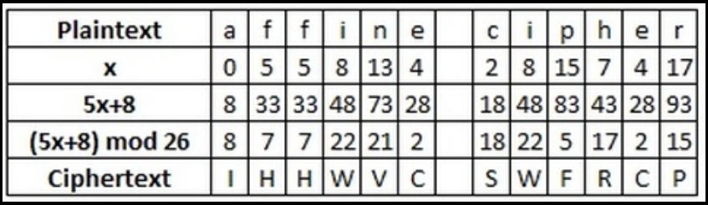
As an example, let us encrypt the plaintext "affine cipher",
using the key a = 5, b = 8.
Encryption:
Firstly we must find the integer value of each of the letters in the plaintext alphabet (the standard alphabet of 26 letters in this case). The table below gives these values.
The affine cipher with a = 5, b = 8. We work out values of letters, then do the calculations, before converting numbers back to letters.
Thus the ciphertext produced is "IHHWVC SWFRCP".

Slide 29
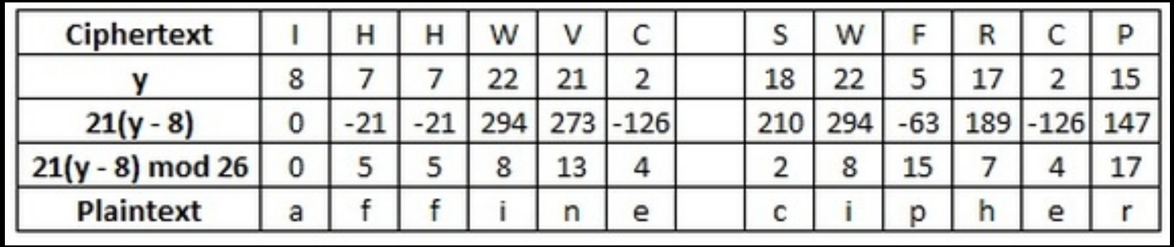
Decryption: (For decryption-only Explain-No Activity)
D(x) = c(x - b) mod m where c is the modular multiplicative inverse of a. (or :::::>>>> D ( x ) = a^-1 ( x - b ) mod m )
That is, a x c = 1 mod m
c is the number such that when you multiply a by it, and keep taking away the length of the alphabet, you get to 1)
Continuing our example, we shall decrypt the ciphertext "IHHWVC SWFRCP", using a key of a = 5, b = 8. The first step here is to find the inverse of a, which in this case is 21 (since 21 x 5 = 105 = 1 mod 26, as 26 x 4 = 104, and 105 - 104 = 1).
We must now perform the inverse calculations on the integer values of the ciphertext. In this case the calculation in 21(y - 8). Once again, we must take these answers modulo 26, and finally convert the integers back to plaintext letters. This is shown in the table below.

Slide 30
SUMMARY
We classify cryptosystems based on number of keys, text processing and operation type .
Substitution is mapping and Transposition is rearranging.
Symmetric use single-key and Assymetric use more than one key.
Caesar and Vigenère ciphers are examples on substitution cipher.
Rail Fence and Playfair Ciphers are examples on Transposition cipher
One-time pad cipher is a type of Vignere cipher
Describe the categories of ciphers depending upon various criteria
Apply Traditional Symmetric Ciphers

